Slide 1
VIRTUAL ASSISTANT
GUDIED BY:
Mr .Udit Narayana Kar
Group Members :
V.T.S.S.Gayathri 19MIS7065
S.Niharika 19MIS7089
S.Preethi 19MIS7048

Slide 2
INTRODUCTION
In modern times, everyday life has become smarter and more sophisticated.
We already know some voice services like google, and Siri. etc.
Now in our voice support system, it can work like automatic chrome, open a social media website in a web browser, tell you the time and you can ask him to tell you from Wikipedia, etc.
Our main voice help agenda makes people smarter and deliver faster results with a computer.
Voice Help captures voice input with our microphone and transforms our voice into understandable computer language providing the necessary solutions and answers that the user asks.

Slide 3
This project works on voice input and give output through voice and displays the text on the screen.
The main agenda of our voice assistance makes people smart and give instant and computed results.
The voice assistance takes the voice input through our microphone (Bluetooth and wired microphone) and it converts our voice into computer understandable language gives the required solutions and answers which are asked by the user.

Slide 4
Literature Review:
TITLE | CONTRIBUTION | RESULTS GENERATED
Scavenge: an intelligent multi-agent based voice-enabled virtual assistant for LMS | The approach and techniques used in Scavenge are novel and innovative that will be a valuable contribution to the overall field of knowledge. | The results have shown that the proposed system has a positive impact on students’ performance and can enhance the usability of LMS.
The Voice Enabled Personal Assistant Using Python | This paper present a comprehensive over view and development of voice enabled personal assistant using python programming language. | This voice enabled personal assistant in todays life style will be more effective in case of saving time, compared to that of previous days. This personal assistant works properly to perform some tasks given by user.

Slide 5
Connecting People Through Virtual Assistant on Google Assistant | This paper presents of how A virtual assistant provides various services to entrepreneurs or businesses from a remote location. From digital marketing tasks, scheduling appointments and managing events to personal errands. You can make a virtual assistant do almost anything. | This system helps people to become smarter and deliver fastest results with in expected time. It helps us to change output from one language to another.
Desktop based Smart Voice Assistant using Python Language | In this paper “Virtual Assistant Using Python” we discussed the design and implementation of Digital Assistance. The project is built using open source software modules with PyCharm community backing which can accommodate any updates shortly. The modular nature of this project makes it more flexible and easy to add additional features without disturbing current system functionalities. | Voice help captures voice input with the microphone and transforms our voice into understandable computer language and helps us in getting better results
VIRTUAL DESKTOP ASSISTANT USING PYTHON | It not only works on human commands but also give responses to the user based on the query being asked or the words spoken by the user such as opening tasks and operations. It is greeting the user the way the user feels more comfortable and feels free to interact with the voice assistant. The application should also eliminate any kind of unnecessary manual work required in the user life of performing every task. The entire system works on the verbal input rather than the next one. | We've created a voice assistant that can perform any task in exchange for commands from users without making any mistakes. We've added more functionality, such as listening to the user's speech solely and not being activated by background noise. This project's modular structure makes it simple to comprehend and more adaptable.

Slide 6
Problem Statement:
User needs to manually accomplish numerous sets of applications to comprehensive single task.
We already have multiple voice assistants but there is problem voice reorganization. There is need of a voice assistant that can understand English in Indian accent & work on it. Voice assistant should be able to model complex tasks, it needs to be tasted for finding optimize path when a task has multiple subtasks & each sub task can have its own sub tasks.

Slide 7
PROBLEM IDENTIFICATION
Connectivity Issues.
Some parts of the globe have slower internet speeds.
Difficulty in communication.
The main issue with virtual assistants is that there is no way to communicate face to face.
Language barriers.
Differences in Time.

Slide 8
METHODOLOGIES:
This project works on by entering the voice and rendering voice output and displaying text on screen.
Accomplished with understanding and intelligent assistant capable of taking user command and analyses it and respond the user by voice media.
The methodology is to the effective way of implementing a personal voice assistant, voice recognition has any inbuilt functions that will let assistant understand the command given by user.

Slide 9
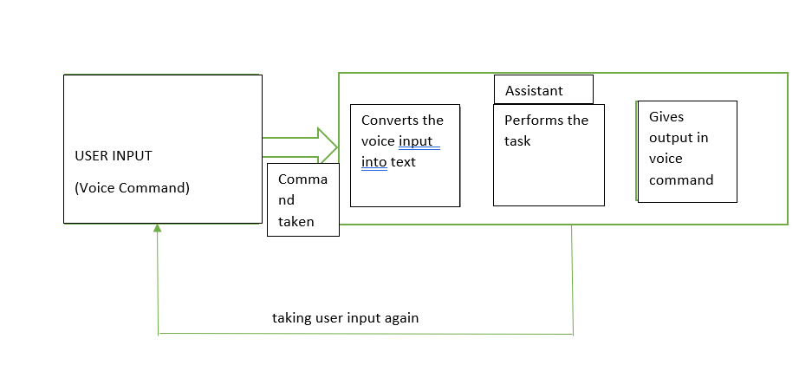
SYSTEM ARCHITECTURE:
This Assistant consists of three modules. First is, assistant accepting voice input from user. Secondly, analysing the input given by the user, and mapping it to the respective intent and function. And the third is, the assistant giving user the result all along with voice.

Slide 10
TECHNOLOGIES USED:
Hardware:
Processor: intel i5 3rd gen or AMD A6.
Ram: 4 GB or more.
computer or a laptop.
Software:
Operating system should be WINDOWS 10 or higher.
Must have python installed

Slide 11
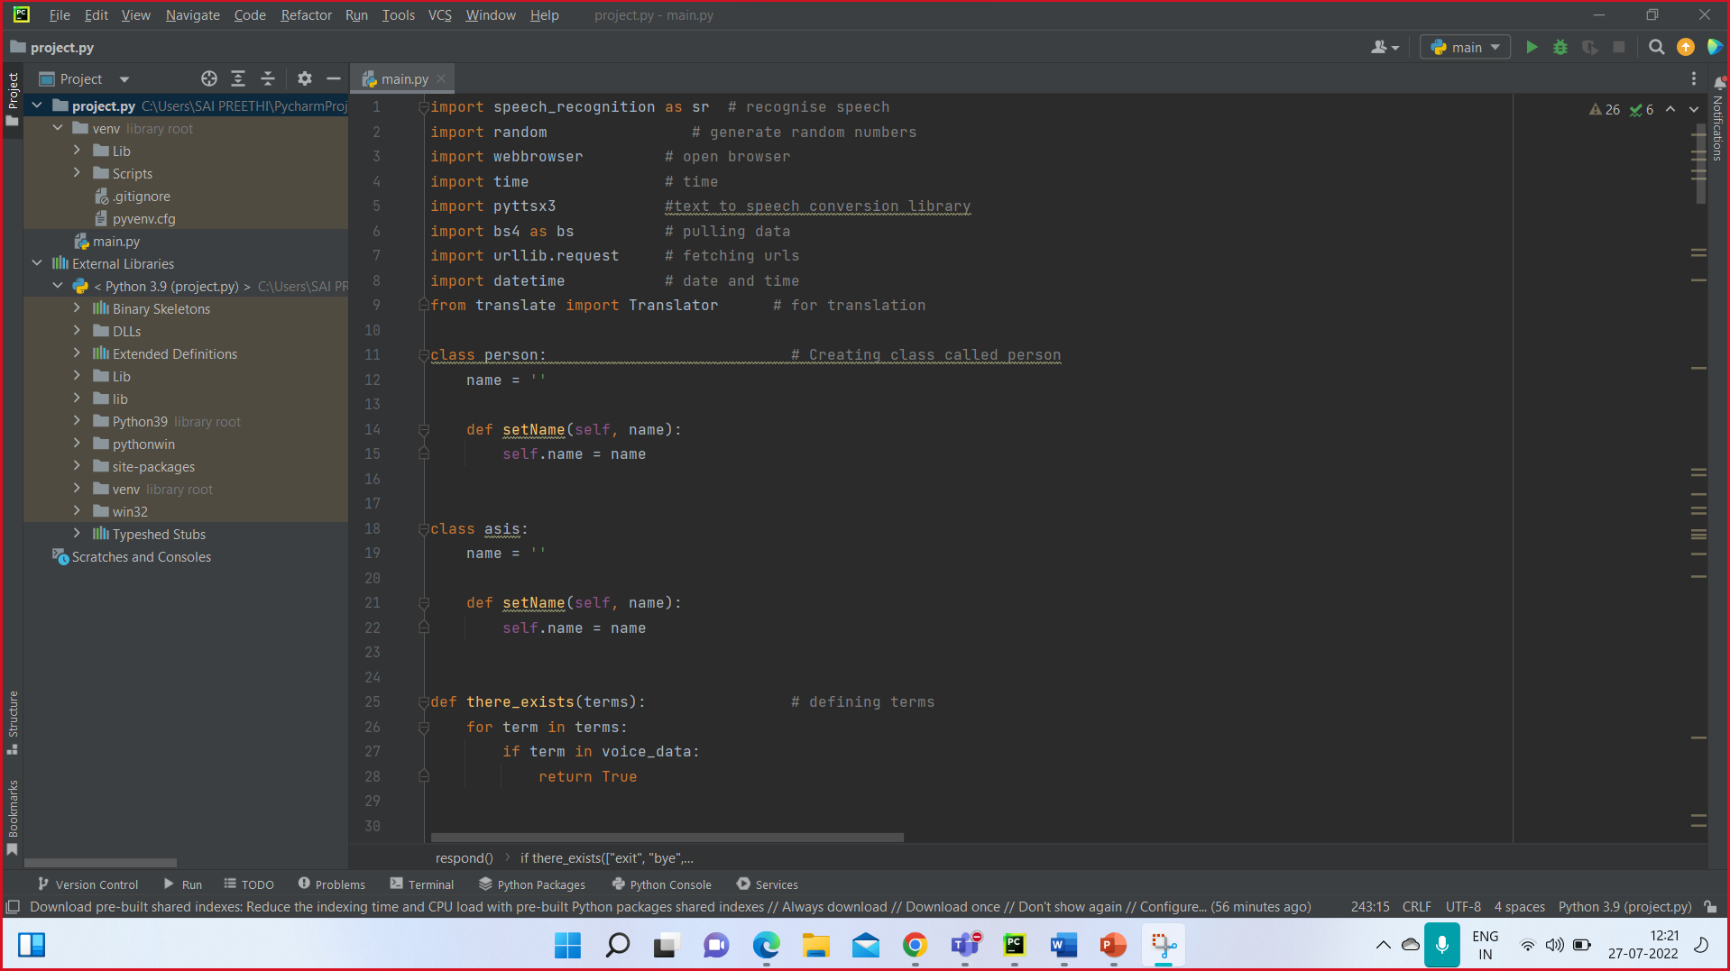
IMPLEMENTATION

Slide 12
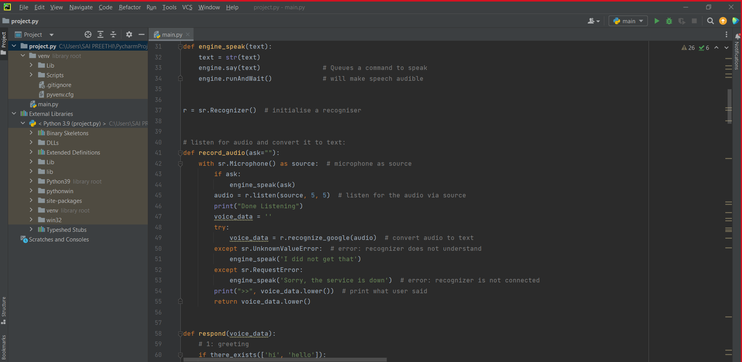

Slide 13
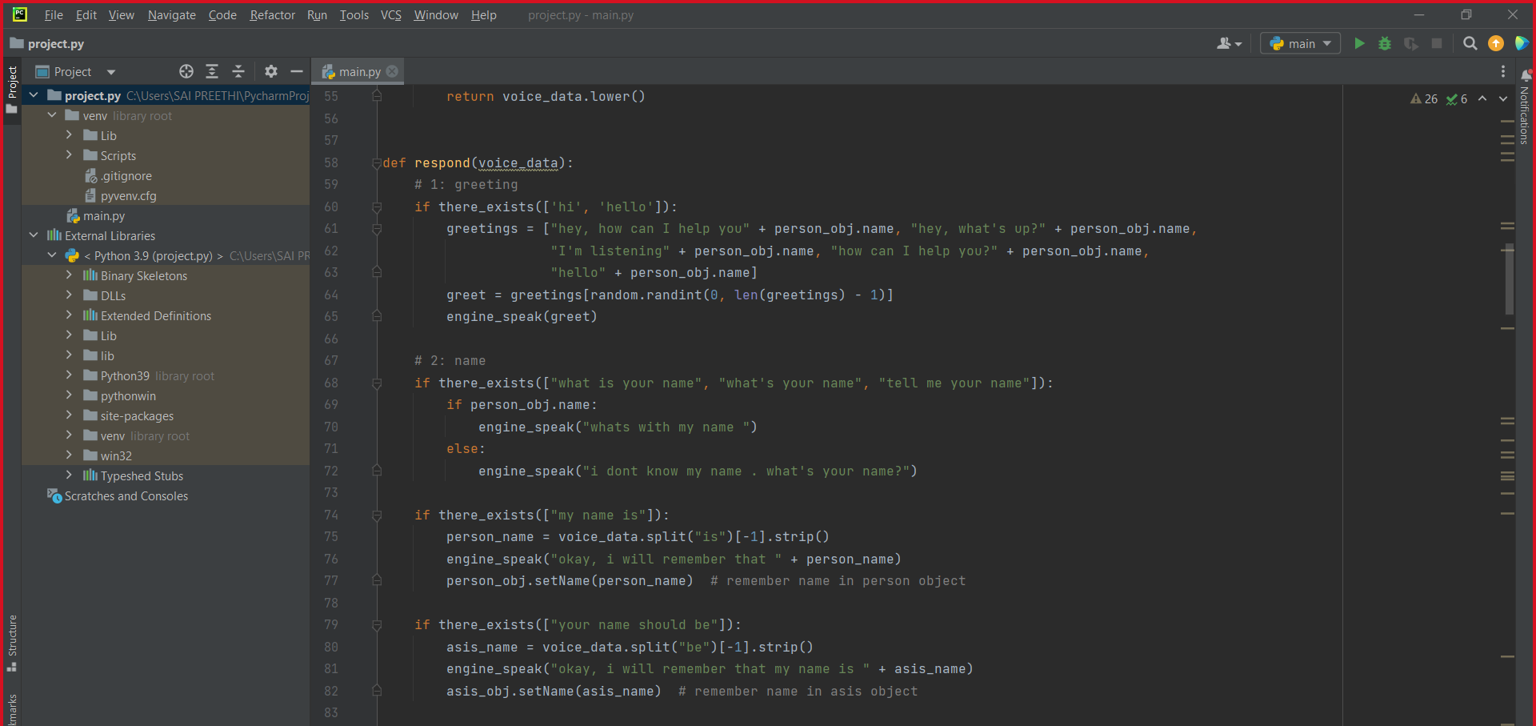

Slide 14
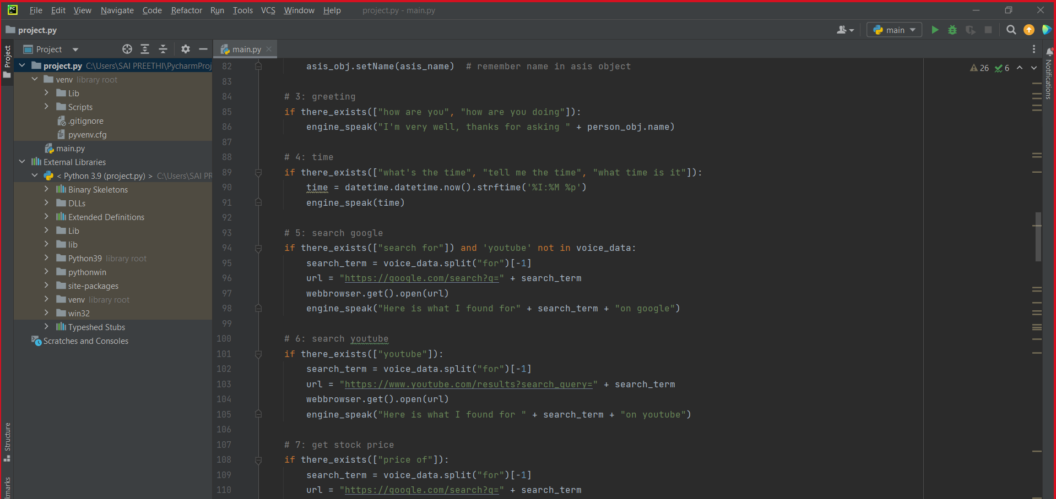

Slide 15
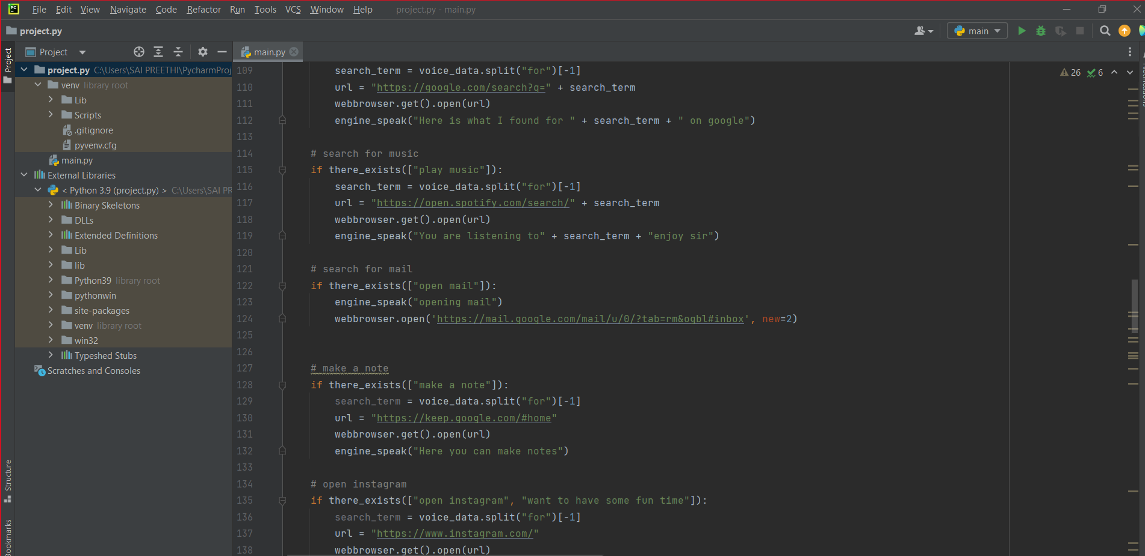

Slide 16
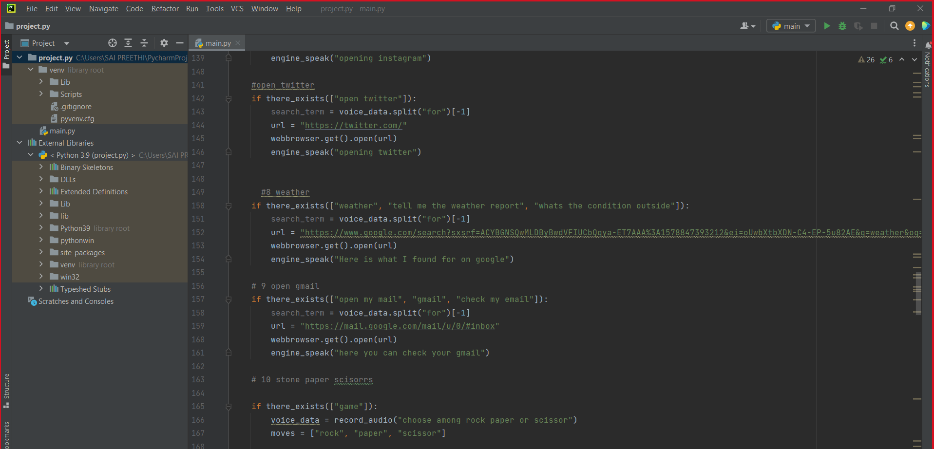

Slide 17
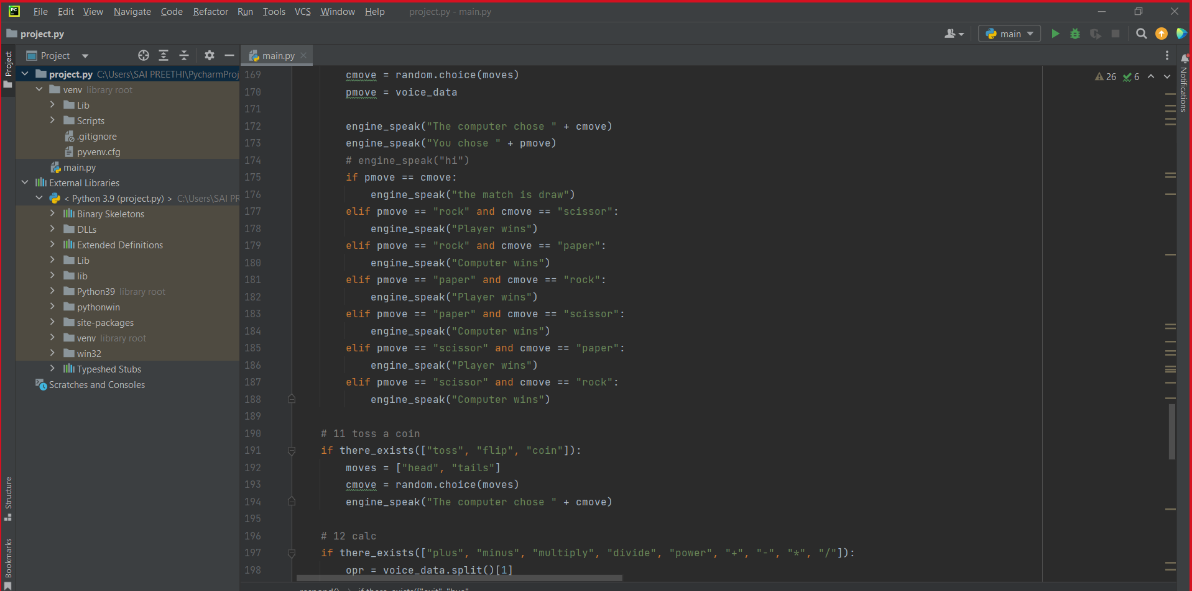

Slide 18
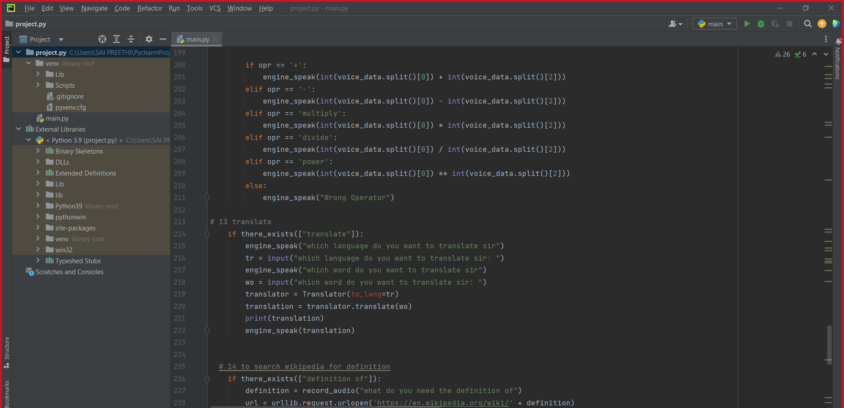

Slide 19
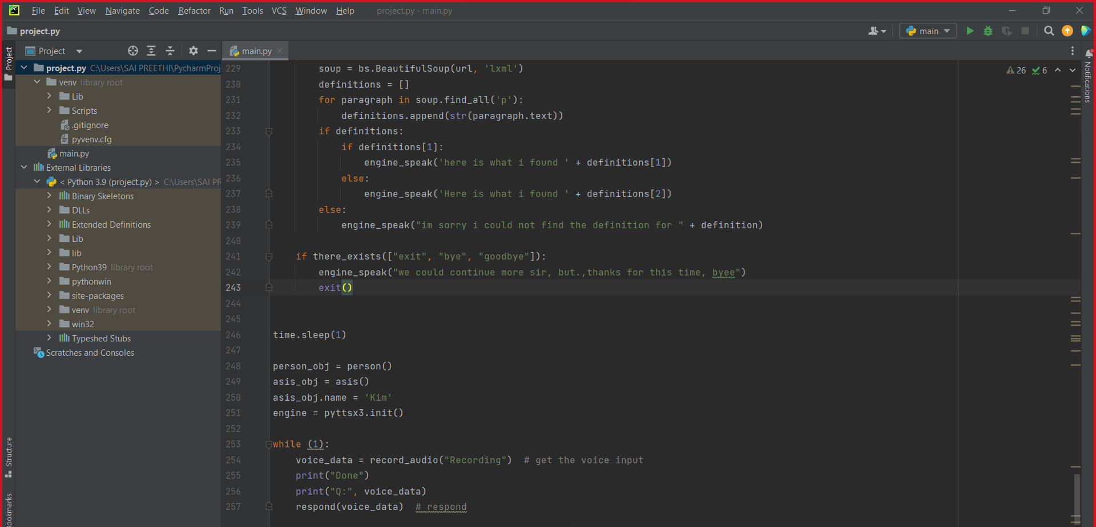

Slide 20
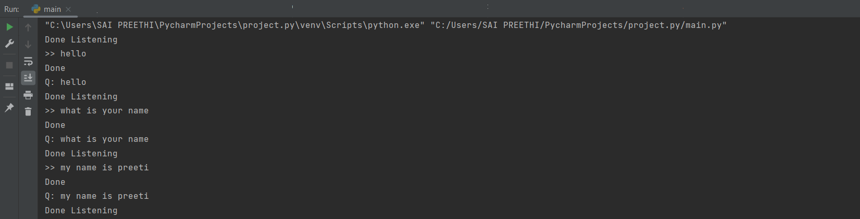
EXPECTED OUTCOMES

Slide 21
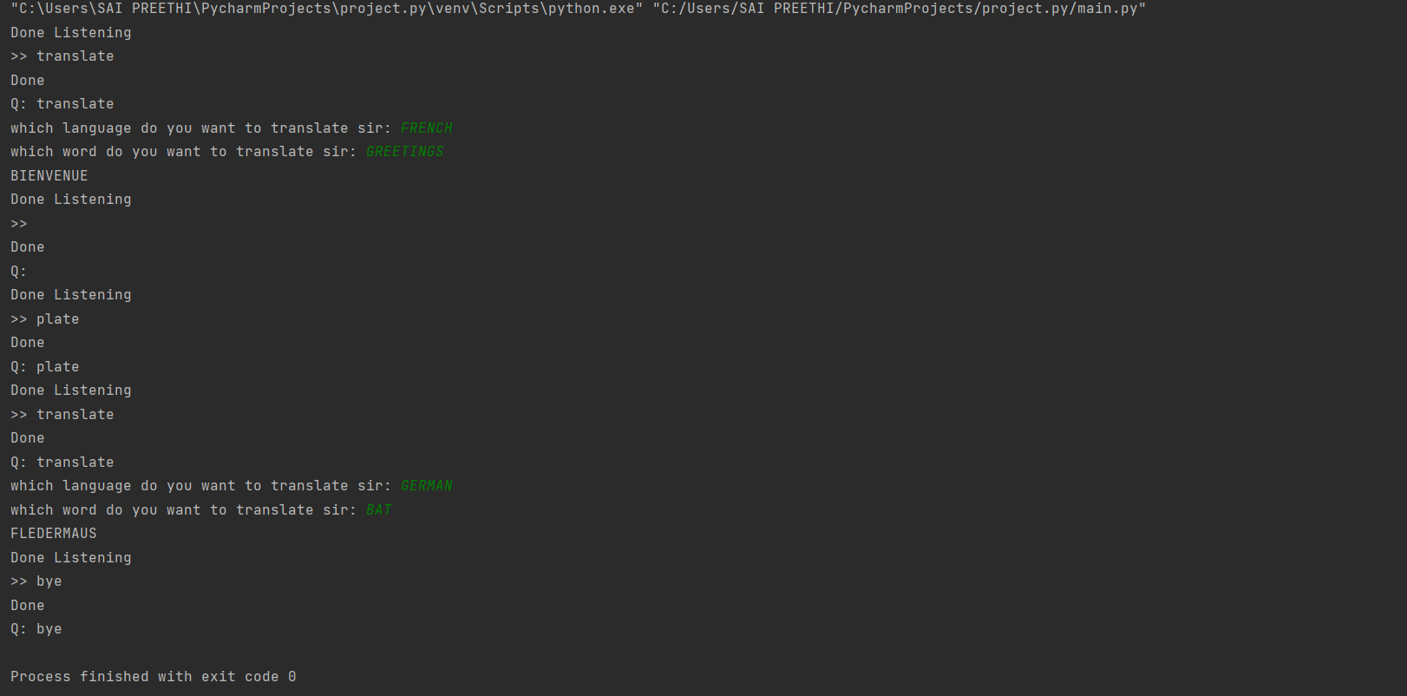
TRANSLATION

Slide 22
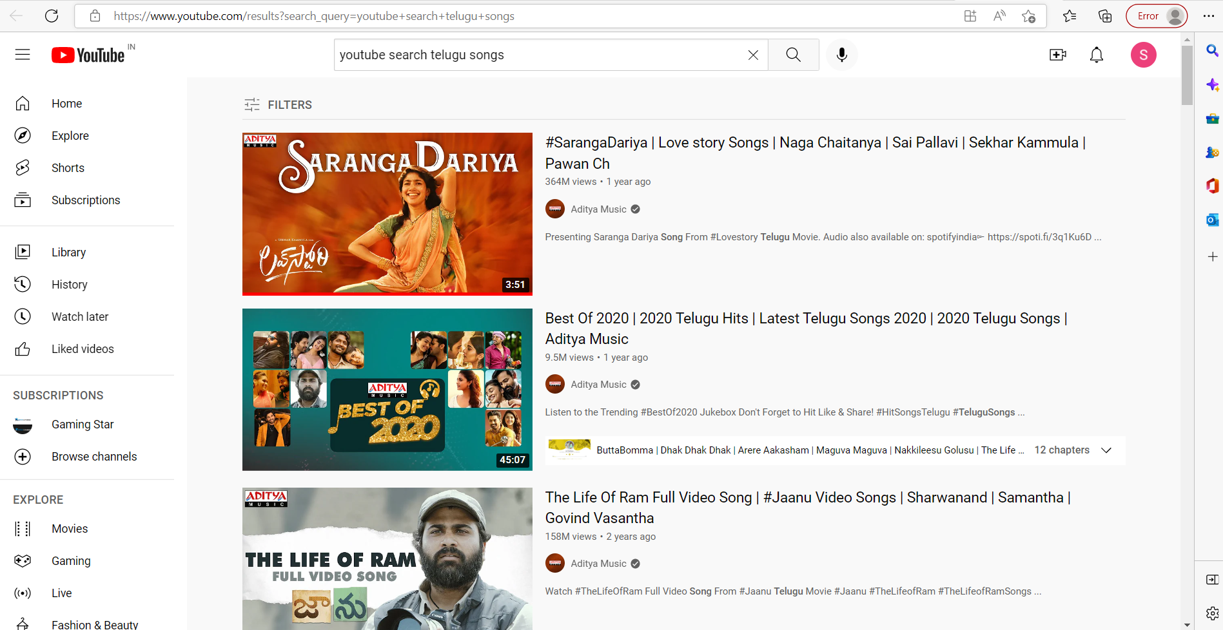
OPEN YOUTUBE:

Slide 23
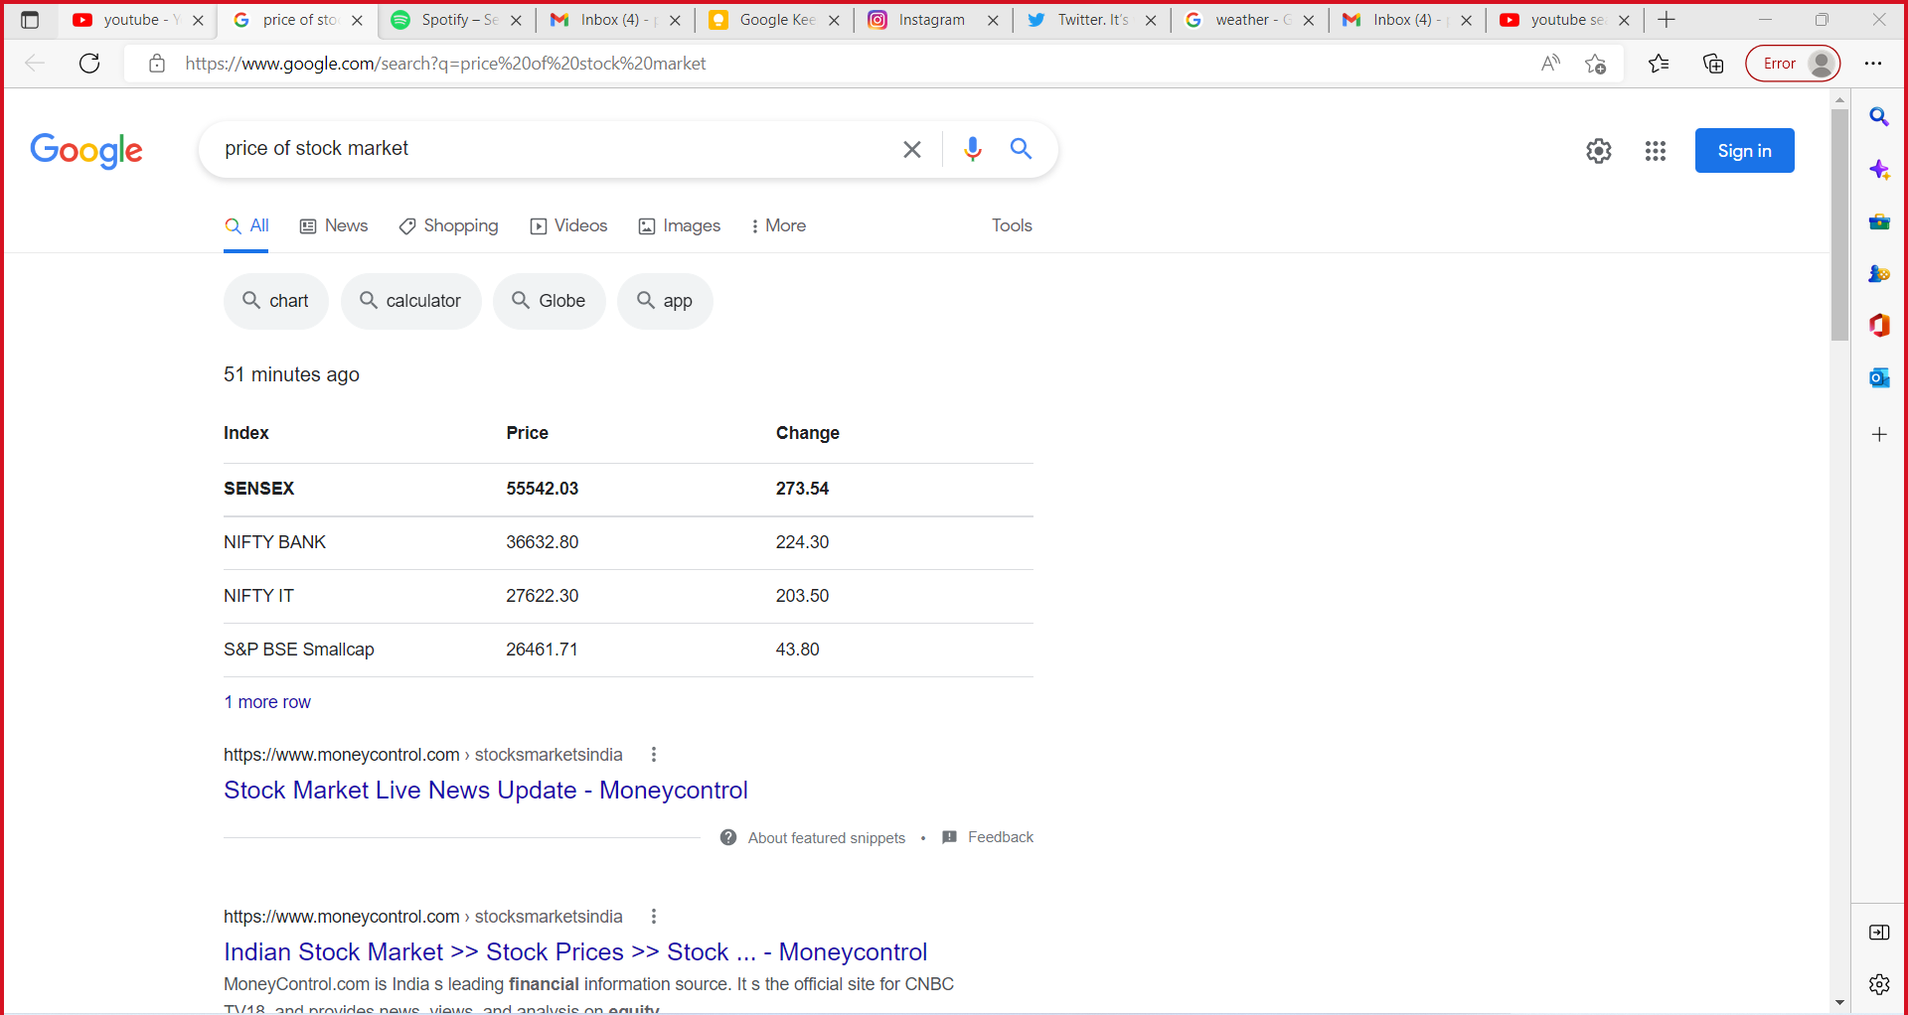
PRICE OF STOCK MARKET

Slide 24
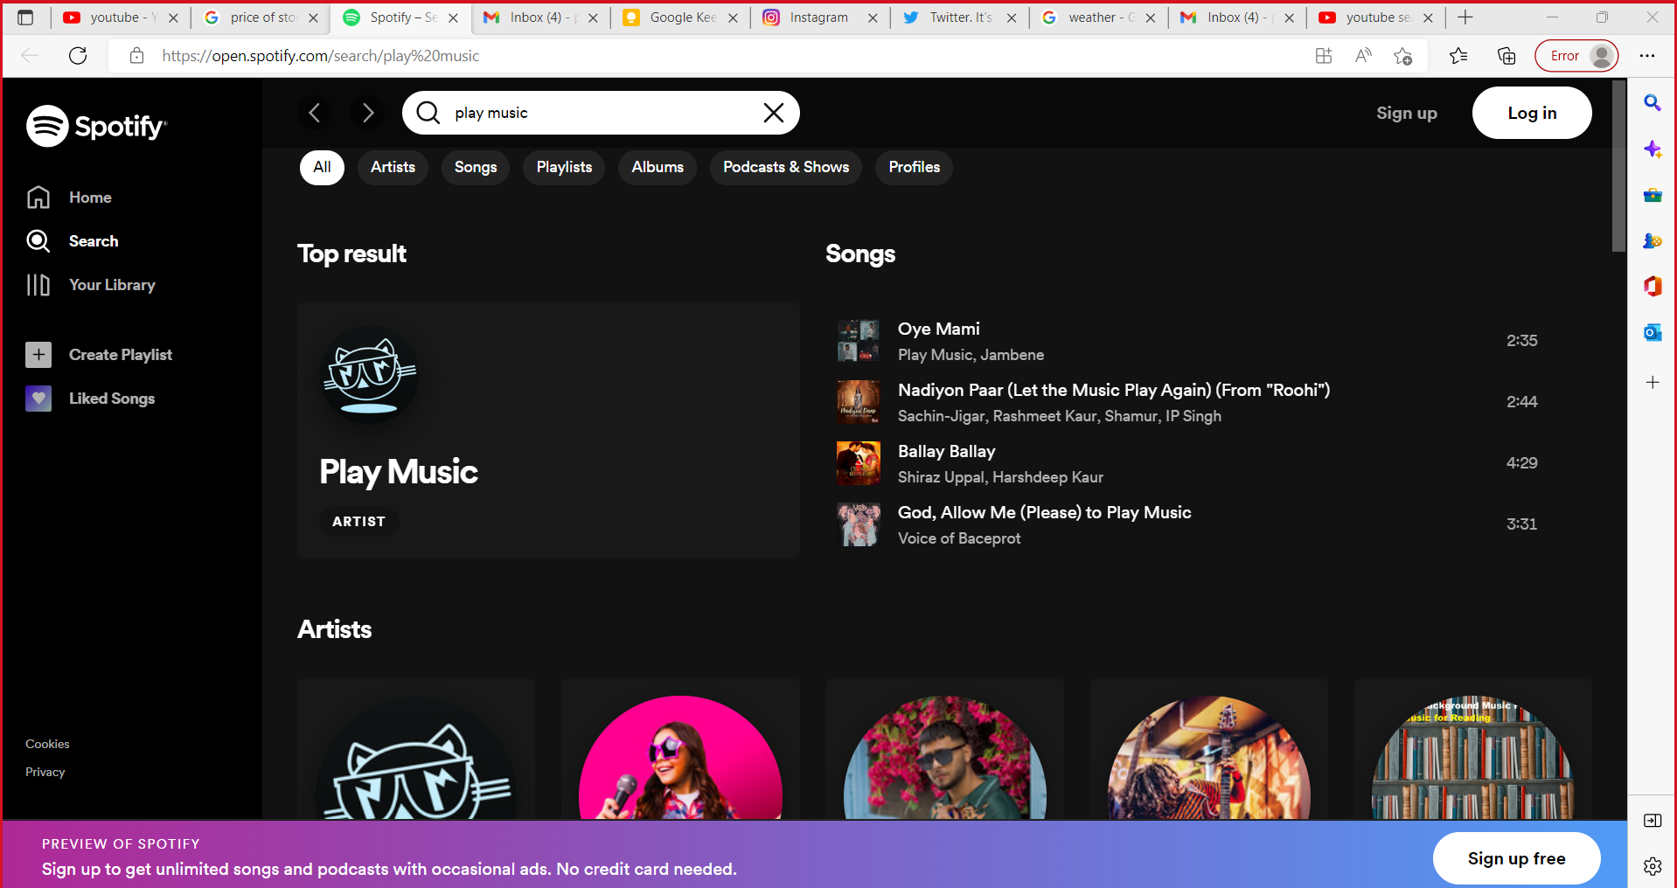
PLAY MUSIC:

Slide 25
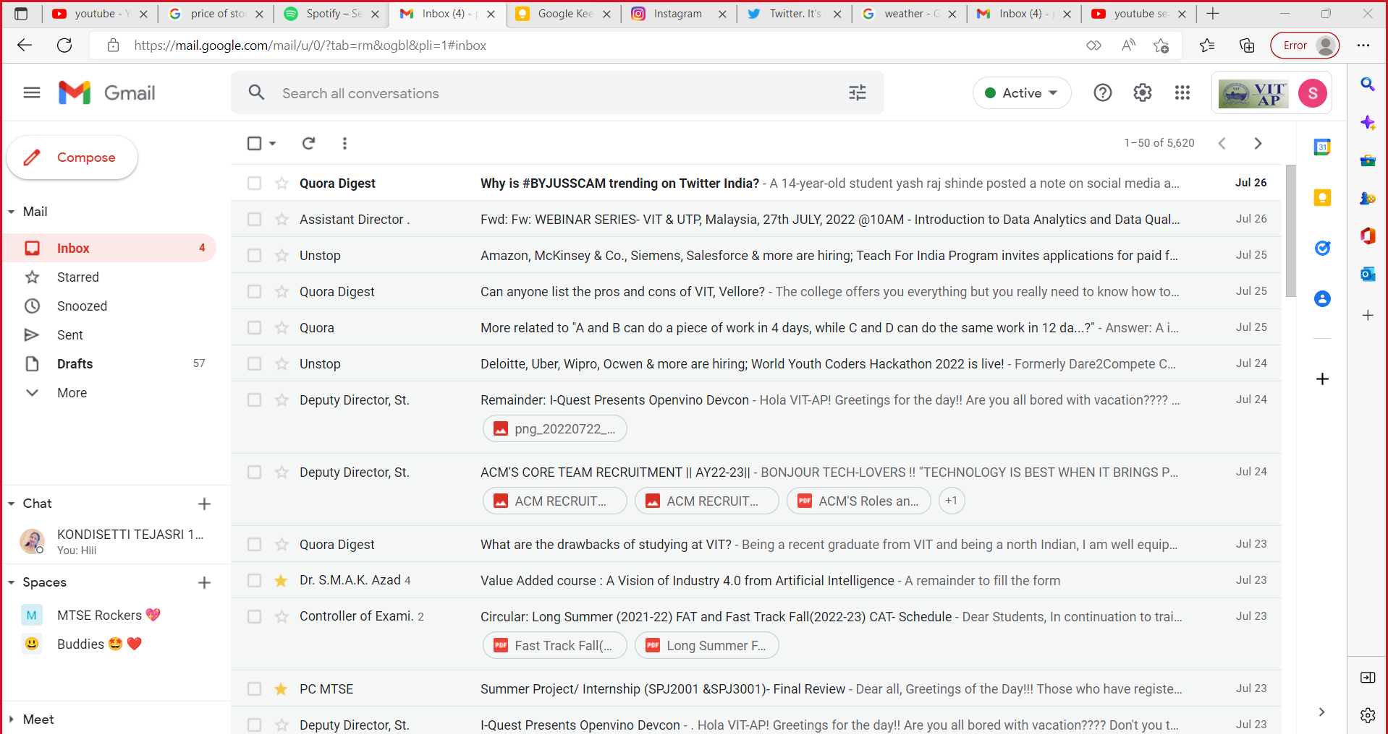
OPEN MAIL

Slide 26
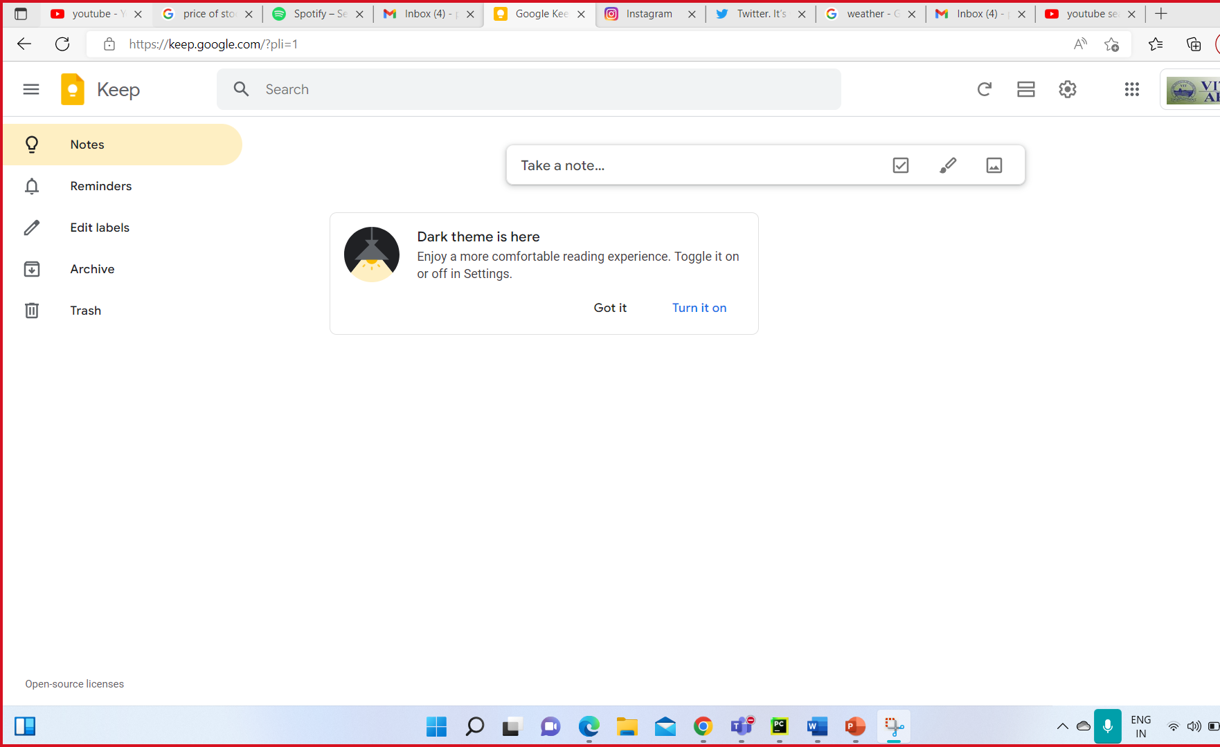
KEEP NOTES:

Slide 27
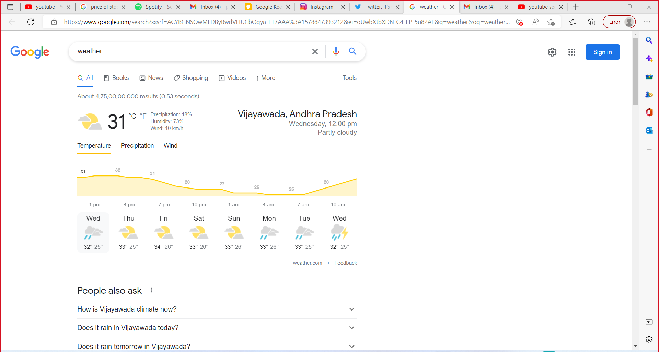
WEATHER REPORT:

Slide 28
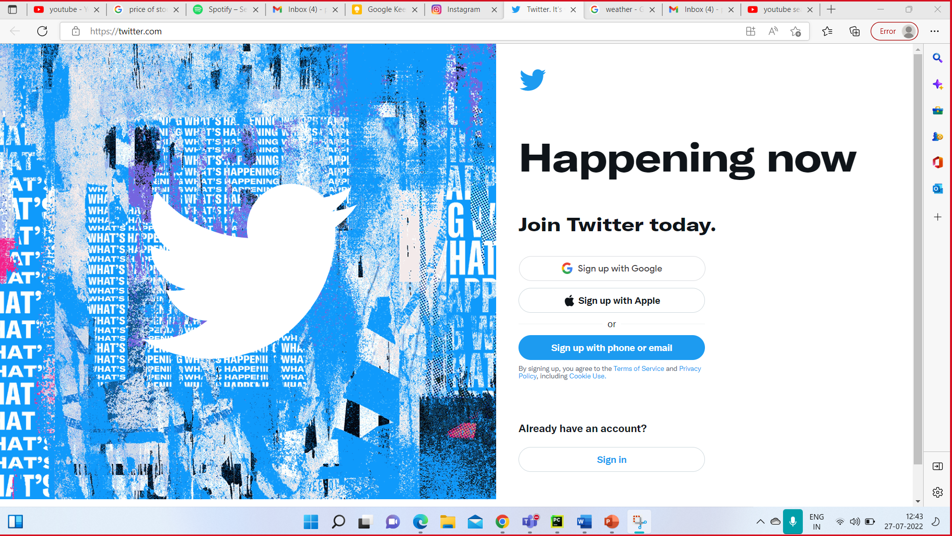
OPEN TWITTER:

Slide 29
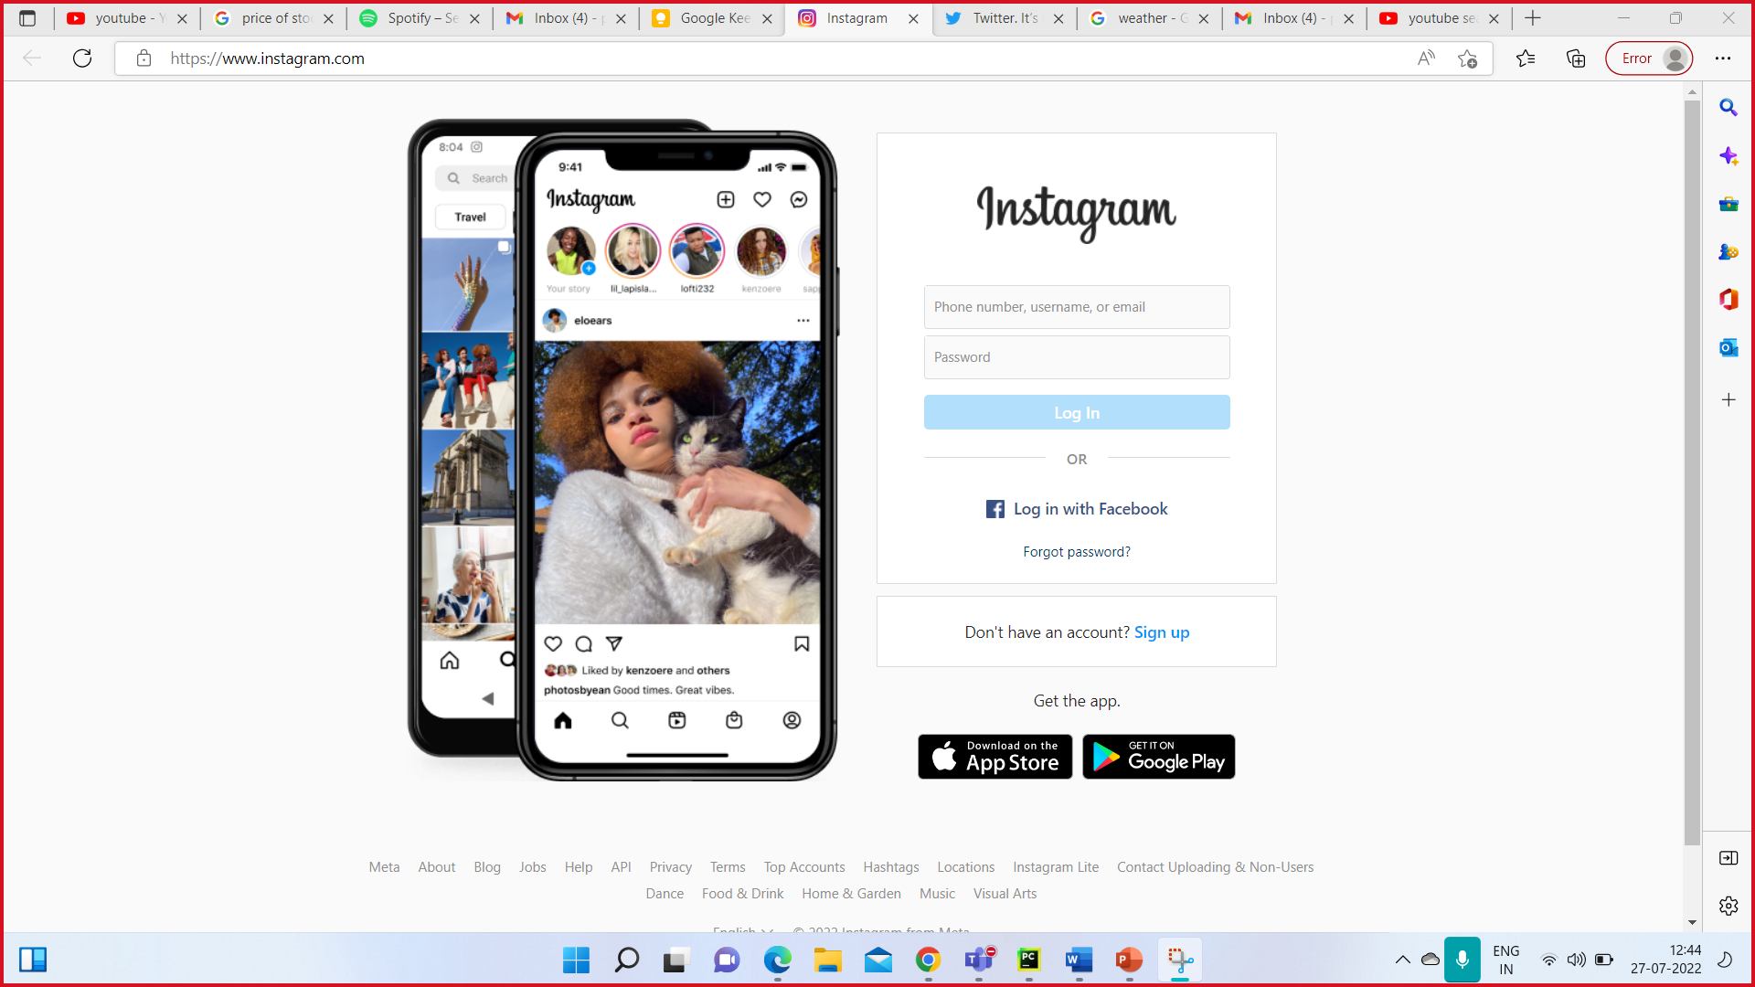
OPEN INSTAGRAM:

Slide 30
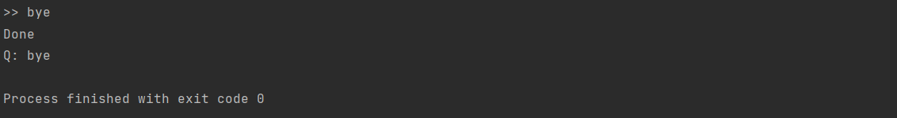
ENDING:

Slide 31
Result Analysis:
Virtual Assistant is a less time consuming, it a software that understands commands and complete task assigned by user.
Virtual assistant uses NLP to match user voices are text input with executable commands.
With the help of virtual assistant you will be able to run your machine on laptop or PCs on your own. It is the fastest process, therefore it saves time .
It is working for you at set time, so always available do you and able to adapt to changing needs quickly.
Our virtual assistant will be able to intimate you with suggestions and taking instructions, and you will know more about you.

Slide 32
Conclusion:
Virtual Assistants are very effective way to program .
Now there are many smart personal digital assistant apps that are available in the market for various platforms. These new software apps works much better than PDA Devices as they provide all the features of the phone.
VPAs also more reliable than personal assistants because they are portable and you can use them at any time. They also have more information than any assistant are connected to the internet.

Slide 33
REFERENCES:
Laeeq, Kashif, and Zulfiqar Ali Memon. "Scavenge: An intelligent multi-agent based voice-enabled virtual assistant for LMS." Interactive Learning Environments 29.6 (2021): 954-972.
Sokol, Kacper, and Peter A. Flach. "Glass-Box: Explaining AI Decisions With Counterfactual Statements Through Conversation With a Voice-enabled Virtual Assistant." IJCAI. 2018.
Austerjost, Jonas, et al. "Introducing a virtual assistant to the lab: A voice user interface for the intuitive control of laboratory instruments." SLAS TECHNOLOGY: Translating Life Sciences Innovation 23.5 (2018): 476-482.
Li, Chen, Andreas Kornmaaler Hansen, Dimitrios Chrysostomou, Simon Bøgh, and Ole Madsen. "Bringing a natural language-enabled virtual assistant to industrial mobile robots for learning, training and assistance of manufacturing tasks." In 2022 IEEE/SICE International Symposium on System Integration (SII), pp. 238-243. IEEE, 2022.

Slide 34
THANK YOU

